Slide 1
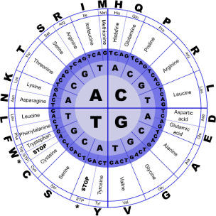
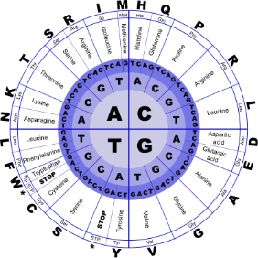


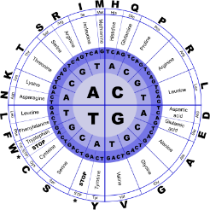
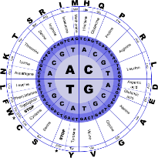
Fundamentals of Programming II
Pointers

Slide 2
Memory
When a variable is declared, the memory needed to store its value is assigned a specific location in memory (its memory address).
C++ programs do not actively decide the exact memory addresses where its variables are stored.
That task is left to the environment where the program is run - generally, an operating system that decides the particular memory locations on runtime.
However, it may be useful for a program to be able to obtain the address of a variable during runtime in order to access data cells that are at a certain position relative to it.

Slide 3
Pointers and the Address Operator
A pointer is a variable which stores the address of another variable.
There are two important operators when working with pointers in C++:
_{the address of (&) operator}
_{the value of (*) operator}
They have been overloaded in C++ so they may have different uses in different contexts.

Slide 4
Pointers and the Address Operator
Each variable in a program is stored at a unique location in memory that has an address
Use the address operator & to get the address of a variable:
int num = -23;
cout << &num; // prints address
// in hexadecimal
The address of a memory location is a pointer

Slide 5
Pointer Variables
Pointer variable (pointer): a variable that holds an address
Pointers provide an alternate way to access memory locations

Slide 6
Pointer Variables
Definition:
int *intPtr;
Read as:
“intPtr can hold the address of an int” or “the variable that intPtr points to has type int”
The spacing in the definition does not matter:
int * intPtr;
int* intPtr;

Slide 7
Pointer Variables
_{myVar = 420;}
_{myPtr = &myVar;}
_{steps = myVar;}
₁st: assigned the value 420 to myVar (a variable whose address in memory we assumed to be 0x453).
₂nd: assigned myPtr the address of myVar , which we have assumed to be 0x453
₃rd: assigned the value contained in myVar to steps . The main difference between the 2nd _{and 3}^{rd} statements is the appearance of the address-of operator (&) The variable that stores the address of another variable (like myPtr in the previous example) is what in C++ is called a pointer.
Pointers are a very powerful feature of the language that has many uses in lower level programming.

Slide 8
Dereference operator (*)
pointers can be used to access the variable they point to directly. This is done by preceding the pointer name with the dereference operator (*). The operator itself can be read as "value pointed to by”.
_{test = *myPtr;}
“test equal to value pointed to by myPtr",
This statement would actually assign the value 420 to test, since myPtr is 0x453, and the value pointed to by 0x453 would be 420
_{See ptr1 and ptr2}

